Slide 1
Goals of UNSCEAR (United Nation Scientific Committee on Effects of Atomic Radiations)
http://unscear.org/unscear/en/publications/scientific-reports.html

Slide 2
The UNSCEAR reports are published to provide authoritative assessments on the levels and effects of exposure to ionizing radiation.
These reports serve several key purposes:
Scientific Evaluation: They compile and analyze data on radiation exposure from various sources, including medical, occupational, and environmental radiation.
Policy Guidance: Governments and international organizations use these reports to develop safety standards and regulations.
Public Awareness: They help clarify the risks and effects of radiation exposure, ensuring informed decision-making.
Historical Documentation: They provide a record of radiation exposure incidents, such as the Fukushima Daiichi nuclear accident.
Support for Research: Scientists and health professionals rely on these reports for studies related to radiation effects on health.

Slide 5
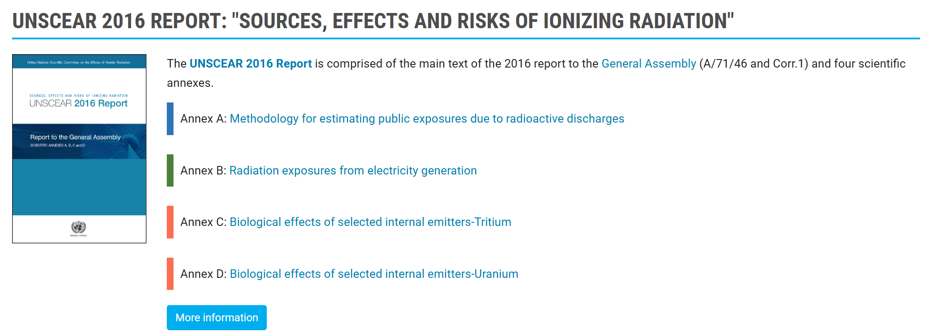

Slide 7
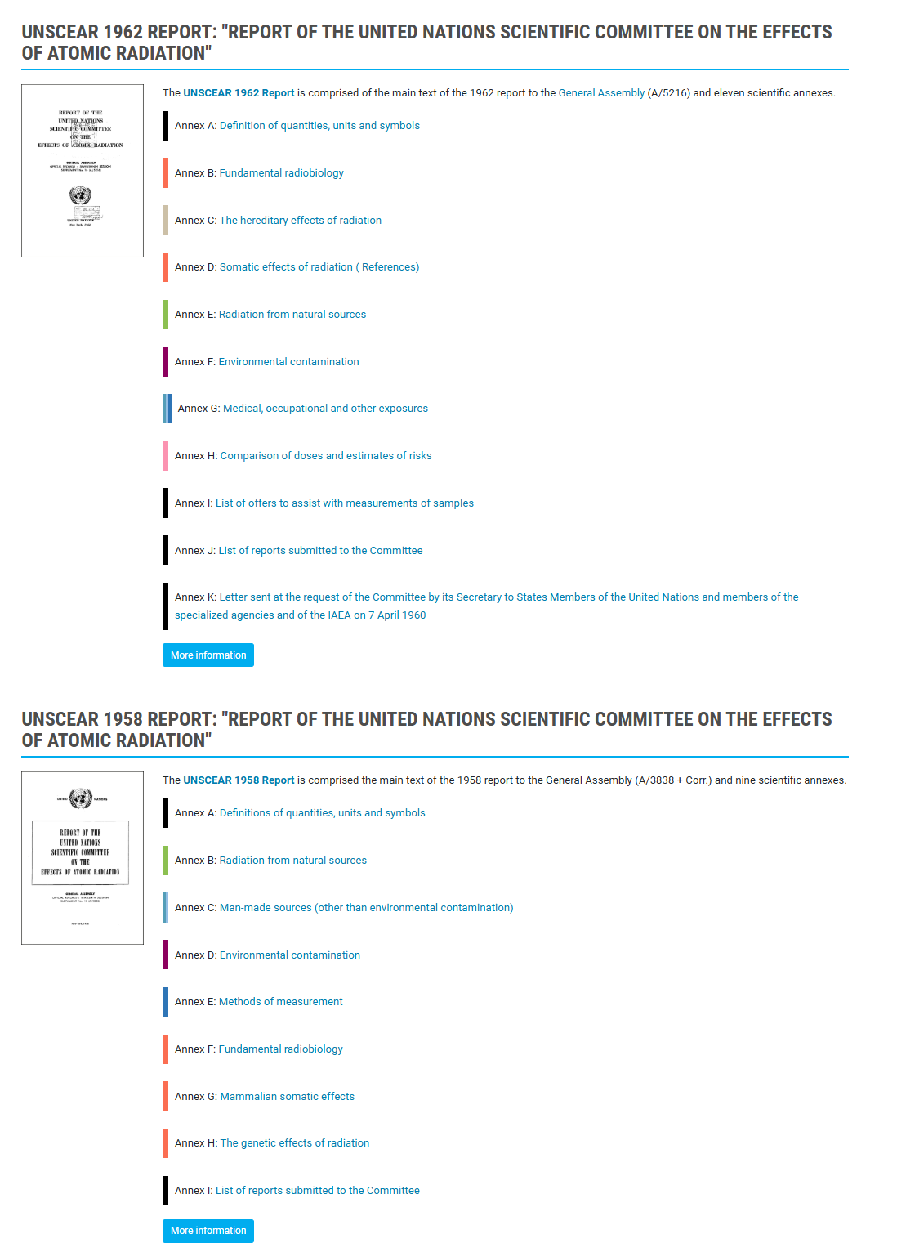
UNSCEAR Report have been issued since 1958

